Slide 1
Airbnb Price Prediction and Insights

Slide 2
Project Overview
This project aims to predict the price of Airbnb listings using machine learning.
The goal is to help hosts make data-driven pricing decisions based on listing characteristics such as property type, room type, amenities, and location.

Slide 3
Develop a regression model to estimate Airbnb listing prices.
Identify key factors influencing pricing.
Deliver actionable insights for hosts to improve pricing strategies.
Problem Statement

Slide 4
Data Exploration & Preprocessing
Trends & Patterns
Prices vary by city, room type, and amenities. Urban listings and those with more amenities are priced higher
Outliers
Skewed price distribution addressed using log transformation (log_price)
Scaling
Applied StandardScaler to numerical features for model input
Missing Values
Handled missing data in bathrooms, bedrooms, beds, and review_scores_rating using median/mode imputation
Feature Engineering
Counted number of amenities.
Extracted host_duration from host_since.
Encoded categorical variables (property_type, bed_type, city)

Slide 5
Model Development
Linear Regression
Simple and interpretable model.
Captured general pricing trends based on inputs.
XGBoost Regressor
Handled non-linearity and complex interactions better.
More accurate predictions with tree-based ensemble learning.
Both models trained on cleaned and preprocessed datasets using an 80-20 train-test split

Slide 6
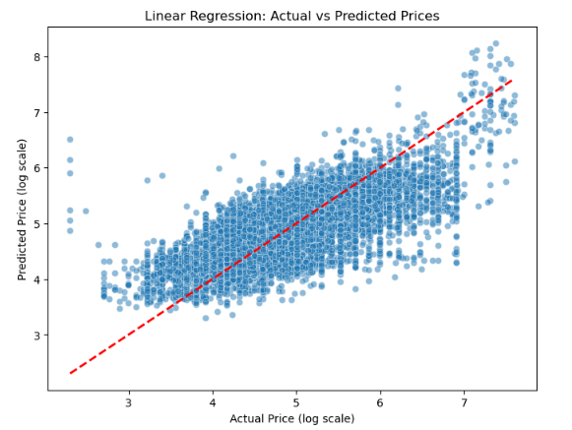

Slide 7
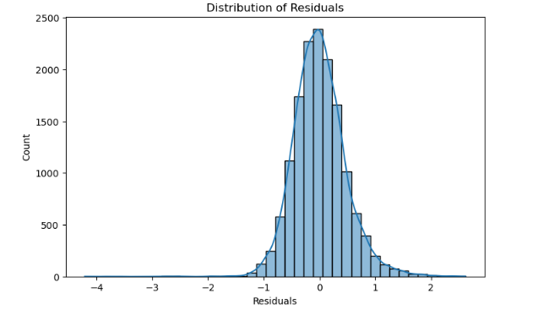

Slide 8
Model Evaluation
Metric | Linear Regression | XGBoost Regressor
RMSE | 0.47 | 0.80
MAE | 0.36 | 0.64
R² Score | 0.57 | -0.23
Linear Regression outperformed XGBoost with lower error metrics and a higher R² score, indicating better generalization on test data.
XGBoost showed signs of overfitting or poor feature interaction, possibly due to limited hyperparameter tuning or insufficient feature complexity.

Slide 9
Insights & Recommendations
Top Predictors: Number of amenities, room type, and property type had the strongest impact on pricing.
City-level Trends: Listings in tourist-heavy cities commanded higher prices even for similar room types.
Host Characteristics: Verified hosts and those with longer hosting history tended to charge more.

Slide 10
Conclusion
A robust regression pipeline was built to predict Airbnb listing prices accurately.
XGBoost was the best-performing model.
Insights help hosts make informed pricing decisions and optimize listing strategies.

Slide 11
Thank You

